Slide 1

Team details
AI-MediAssist: A Conversational Agent for
Healthcare Guidance
S.NO | NAME | REG.NO
1 | G. GANESH | 99220042094
2 | S. HARI | 99220041678
3 | E.V. KRISHNA PRASAD | 99220042151
4 | T. RAMANA | 99220041686
GUIDED BY:
P. KALAIARASI

Slide 2
Problem Statement
The healthcare sector challenges such as limited access to doctors in rural and underserved regions, long waiting times, and an increased burden on medical staff due to repetitive queries. Moreover, the lack of real-time 24/7 medical assistance and the absence of integrated image analysis with NLP in existing systems hinder accurate and timely preliminary diagnosis.

Slide 3
ABSTRACT
Timely and good access to healthcare is still a big challenge, especially in rural and semi-urban areas that have limited access to a healthcare facility and healthcare professional. To bridge this gap, we offer ViteaSense, a smart and scalable Virtual Doctor Assist Agent platform that uses Cloud technology, Machine Learning (ML), and Artificial Intelligence (AI) to provide medical consultation and intelligent diagnostics remotely. ViteaSense allows patients to see verified doctors over video calls, schedule appointments, upload medical records, and receive prescriptions and recommendations from home. Significantly, the platform explicitly provides an AI model that identifies medical images that can be used to support early diagnosis of diseases such as brain tumors, lung infections, and skin diseases. The services of this platform include multilingual support (includes English, Tamil, and Telugu) to accommodate users from diverse language groups while providing a data privacy and protection model that provides encryption. ViteaSense aims to create a reliable, affordable, accessible health ecosystem and allows for users to access a user- friendly interface, while a back-end approval system for doctors. Viteasense uses a deep learning model to validate its performance. It follows the guidelines outlined by national and international telemedicine regulators to pursue real world application.

Slide 4
Objective
Develop a real-time AI system to continuously monitor patient vital signs using wearable devices and sensors. Enable analysis of medical images and live webcam input for condition detection. Provide real-time preliminary medical support, including treatment suggestions and guidance. Improve healthcare accessibility, especially in rural and underserved regions. Reduce the workload of healthcare professionals by automating repetitive queries. Ensure strong data privacy, security, and compliance with medical regulations. Design the system to be scalable, multilingual, and easy to deploy across various devices.

Slide 5
LITERATURE SURVEY
Author & Year | Approach / Model | Key Features | Limitations | Our Contribution(AI-MediAssist)
Chaturvedi et al. (2024) [1] | AI virtual assistant with multilingual support | Diagnostic accuracy, remote consultation | Limited ethical analysis | Added multiple scans+ secure diagnostics with privacy
Dave & Patel (2023) [2] | IoT-based AI health monitoring | Low-cost, real-time alerts | Small-scale, limited scalability | Scalable cloud-based system with ML models
Guo & Chen (2025) [3] | AI vs. human consultation study | Focused on patient perception | Lacked real-time integration | Real-time physician integration + AI diagnostics
Olawade et al. (2024) [4] | AI automation in healthcare | Personalized care, predictive analytics | General theoretical model | Implemented practical AI with video consultation
Kolbinger et al. (2024) [5] | Reporting guidelines for medical AI | Emphasized governance & reproducibility | No system implementation | Developed operational system meeting standards

Slide 6
PROJECT OVERVIEW:
Web-based smart healthcare platform.
Patients can book appointments and access AI predictions.
Doctors manage appointments and digitally.
Admin monitors and controls the system.
Integrated chatbot for basic healthcare guidance.

Slide 7
Technology Stack
Category | Technologies / Models Used
Frontend | HTML, CSS, JavaScript
Backend | Flask (Python)
Database | SQLite
Machine Learning Models | Convolutional Neural Network (CNN), Decision Tree
ML Frameworks & Libraries | TensorFlow, Scikit-learn

Slide 8
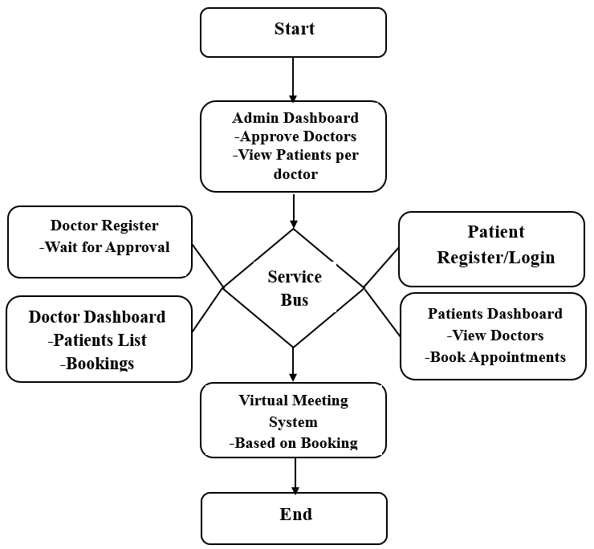
System architecture

Slide 9
SYSTEM USERS:
Patients: Appointment booking, disease prediction, scan upload.
Doctors: Appointment approval, prescription generation.
Admin: User management, system monitoring.

Slide 10
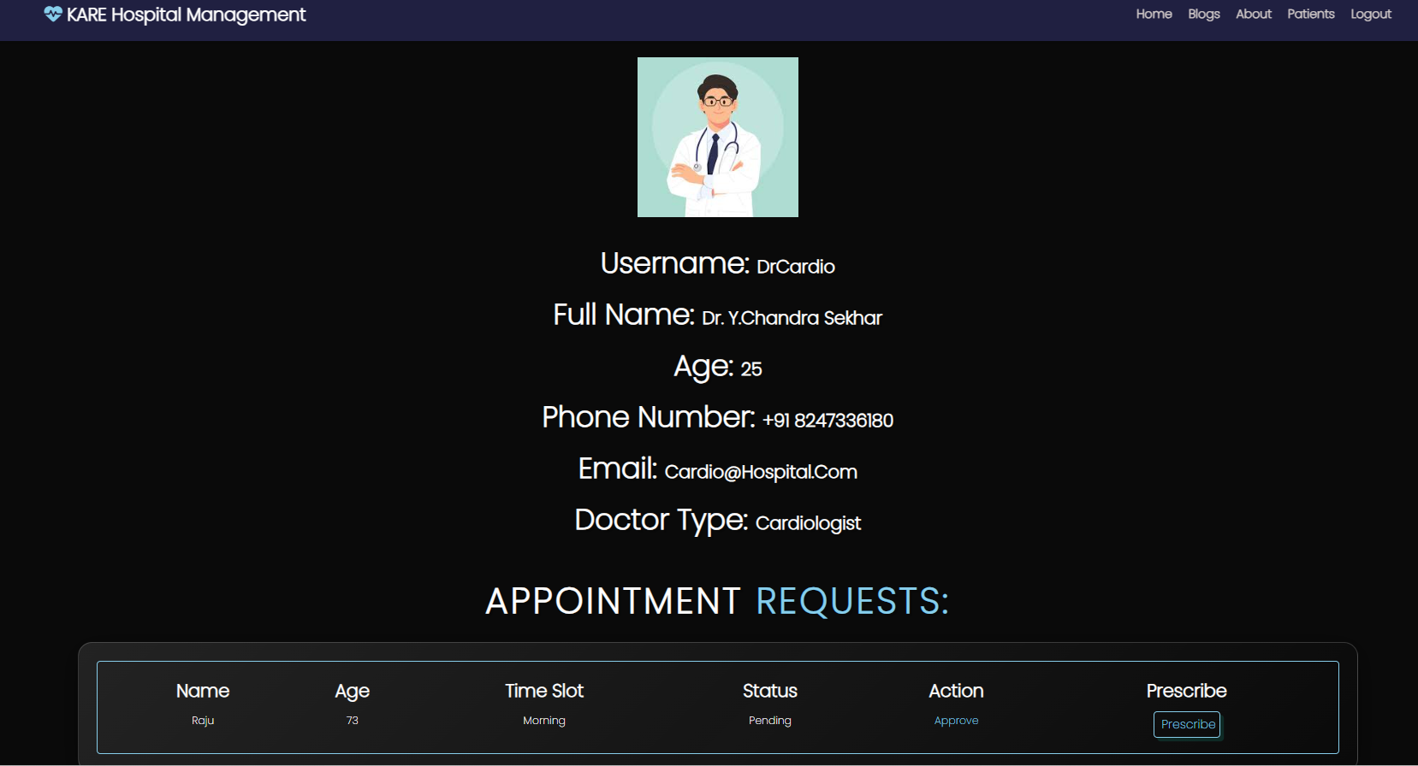
DOCTOR DASHBOARD:
View patient appointment requests.
Approve or reject appointments.
Generate digital prescriptions.
Access patient medical details.

Slide 11
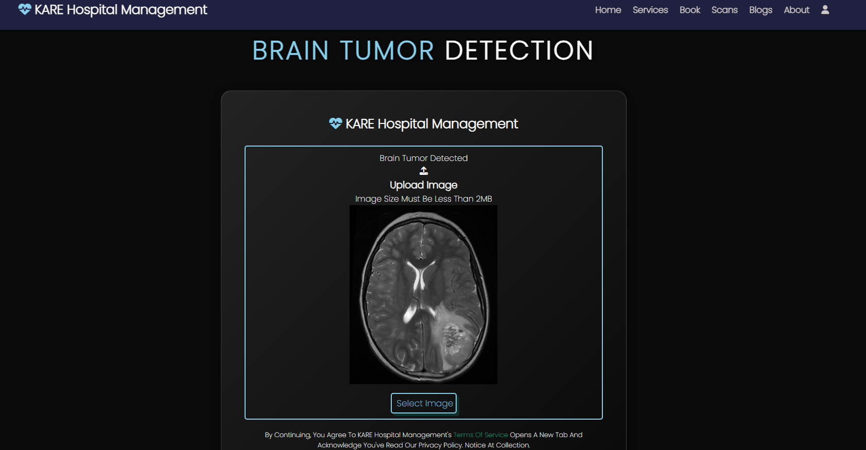
BRAIN TUMOR DETECTION:
CNN-based MRI image analysis.
Detects presence of brain tumors.
Uses deep learning image classification.
Provides visual and prediction output.

Slide 12
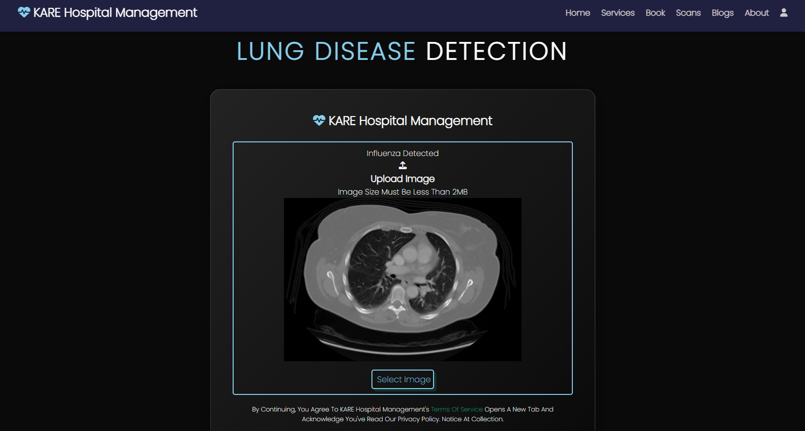
LUNG DISEASE DETECTION:
Lung disease screening using medical images.
Detects lung cancer and influenza patterns.
Machine learning-assisted diagnosis.
Helps in early disease detection.

Slide 13
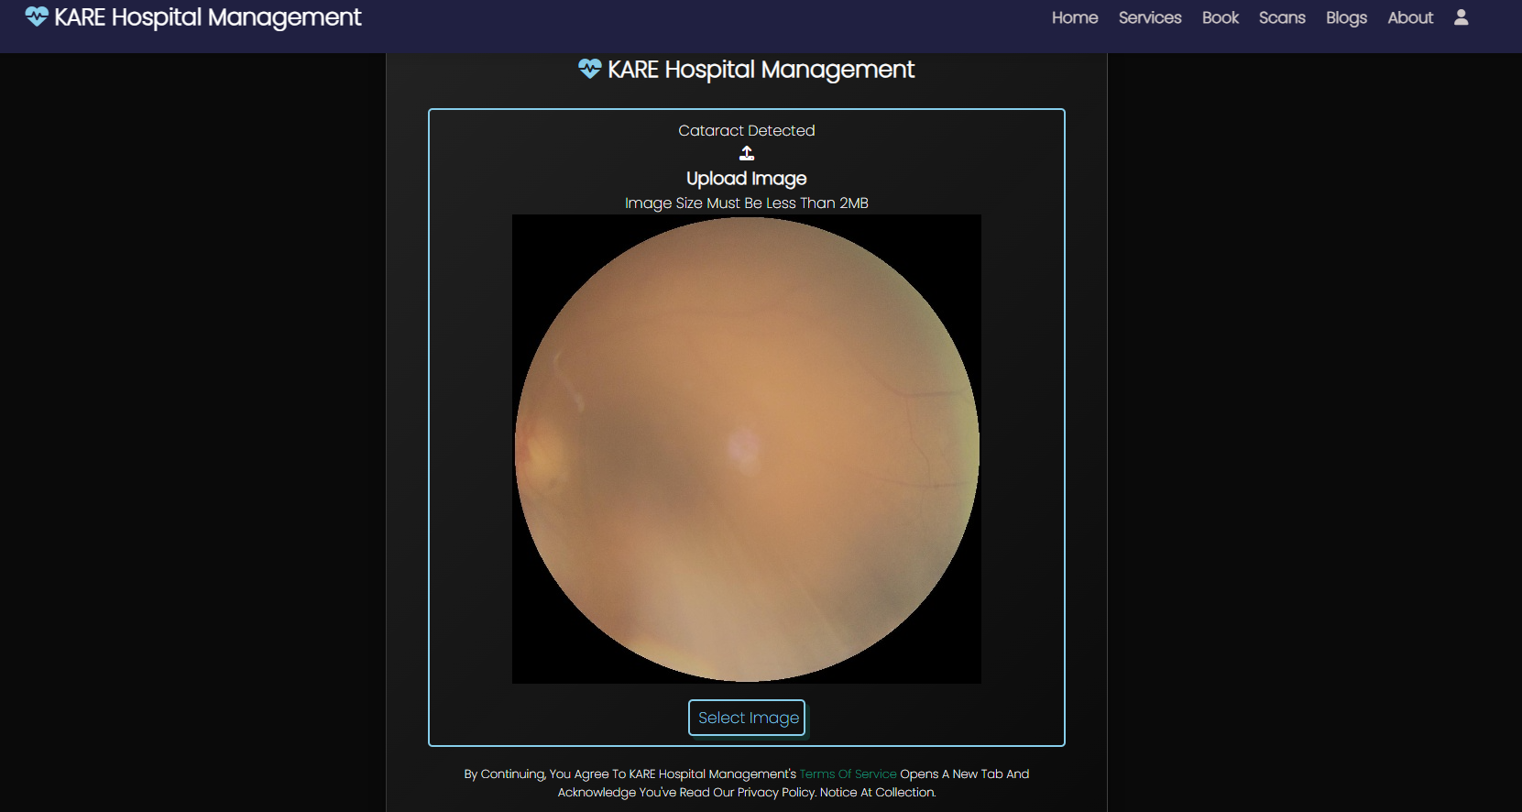
CATARACT DETECTION:
Image-based eye screening system.
Detects cataract presence.
Supports early diagnosis and treatment planning.
Simple image upload and result display.

Slide 14
Core Functionality (KEY FEATURES)
Symptom Analysis: via text input.
Medical Image Analysis: uploaded images / live webcam.
Treatment Suggestions & Guidance
24/7 Automated Healthcare Support
Video Consultation: Enables secure, high-quality virtual consultations between patients and healthcare providers for real-time interaction regardless of location.
Image Classification for X-Ray Disease Detection: Utilizes AI-powered image recognition to analyze X-ray images and assist in early detection of diseases such as pneumonia, tuberculosis, or fractures, enhancing diagnostic accuracy and speeding up treatment decisions.
Appointment Booking :Allows patients to easily schedule, reschedule, or cancel appointments through an intuitive interface, improving convenience and reducing wait times

Slide 15
FUTURE ENHANCEMENTS:
Development of mobile applications for Android and iOS platforms.
Deployment on cloud platforms for better scalability and availability.
Integration with IoT-based health monitoring devices.
Addition of more AI models for detecting multiple diseases.
Advanced analytics and real-time health monitoring features.

Slide 16
CONCLUSION
The proposed AI Medical Chatbot is a step towards accessible, intelligent, and real-time healthcare support. Unlike existing systems, it integrates image recognition + NLP-based symptom analysis, making it more reliable and user-friendly. While not a replacement for medical professionals, it serves as a preliminary healthcare assistant, reduces the workload of doctors, and empowers patients with instant guidance, especially in regions with limited medical infrastructure.

Slide 17
REFERENCES
U. Chaturvedi, S. B. Chauhan, and I. Singh, “The impact of artificial intelligence on remote healthcare: Enhancing patient engagement, connectivity, and overcoming challenges,” Intell. Pharm., vol. xxx, no. xxx, pp. 2025. Available: https://doi.org/10.1016/j.ipha.2024.12.003
M. Dave and N. Patel, “Artificial Intelligence in Healthcare and Education,” British Dental Journal, vol. 234, no. 10, pp. 760–763, May 2023.
L. Guo and Y. Chen, “Can AI replace human physicians? Patient-centered evaluations of medical consultations from functional, relational, and emotional perspectives,” J. Med. Internet Res., vol. 27, p. e66760, 2025. doi: 10.2196/66760
D. B. Olawade, A. C. David-Olawade, O. Z. Wada, A. J. Asaolu, T. Adereni, and J. Ling, “Artificial intelligence in healthcare delivery: Prospects and pitfalls,” J. Med. Surg. Public Health, vol. 3, p. 100108, 2024, doi: 10.1016/j.glmedi.2024.100108
F. R. Kolbinger, G. P. Veldhuizen, J. Zhu, D. Truhn, and J. N. Kather, “Reporting guidelines in medical artificial intelligence: a systematic review and meta-analysis,” Communications Medicine, vol. 4, no. 71, pp. 1–13, 2024, doi: 10.1038/s43856-024-00492-0.

Slide 18
THANK YOU !

